Slide 1
Ejemplos de IEEE 754

Slide 2
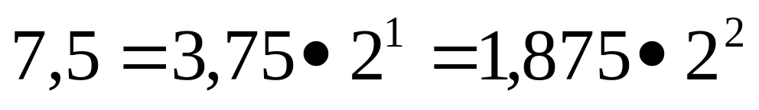
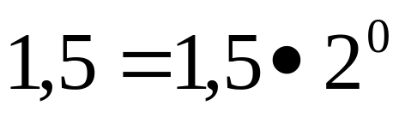
Conversión I

Slide 3
Conversión II
7,5 →
0
10000001
11100000000000000000000
1,5 →
0
01111111
10000000000000000000000

Slide 4
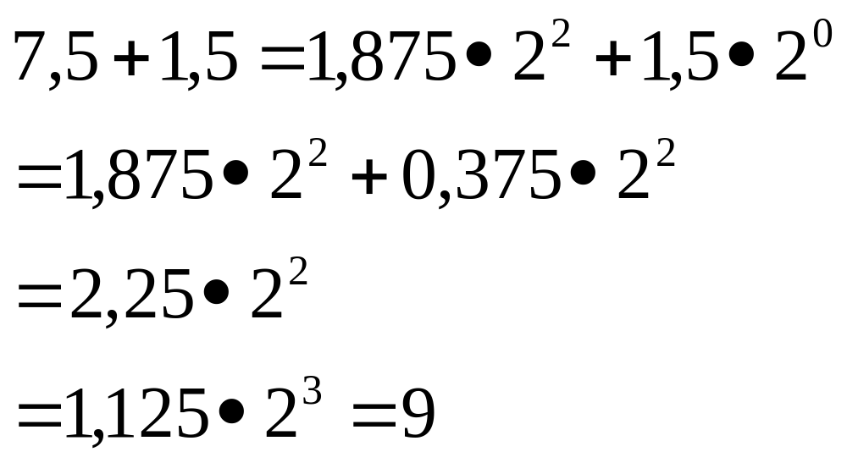
Suma I

Slide 5
Suma II
7,5 →
0
10000001
1.11100000000000000000000
1
1
1,5 →
1,5 →
+
1,5 →
0
01111111
1.10000000000000000000000
0
10000000
0.11000000000000000000000
0
10000001
0.01100000000000000000000
1
9 →
9 →
0
0
10000010
10000001
10.01000000000000000000000
1.00100000000000000000000

Slide 6
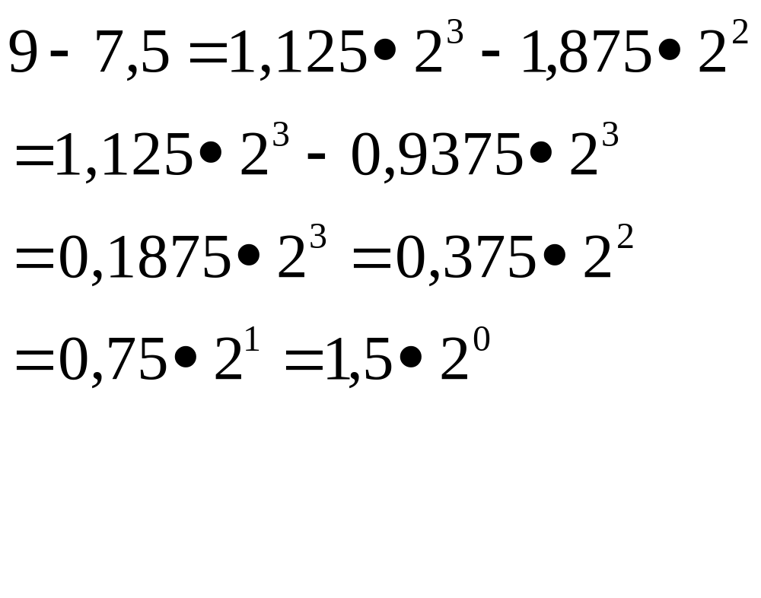
Resta I

Slide 7
Resta II
9 →
0
10000010
1.00100000000000000000000
1
1
-
7,5 →
7,5 →
-7,5 →
0
10000001
1.11100000000000000000000
0
1
10000010
10000010
0. 11110000000000000000000
1.00010000000000000000000
1
1
1
1,5 →
1,5 →
1,5 →
1,5 →
0
10000000
0.11000000000000000000000
0
0
0
10000010
10000001
01111111
0.001100000000000000000000
0.01100000000000000000000
1.10000000000000000000000

Slide 8
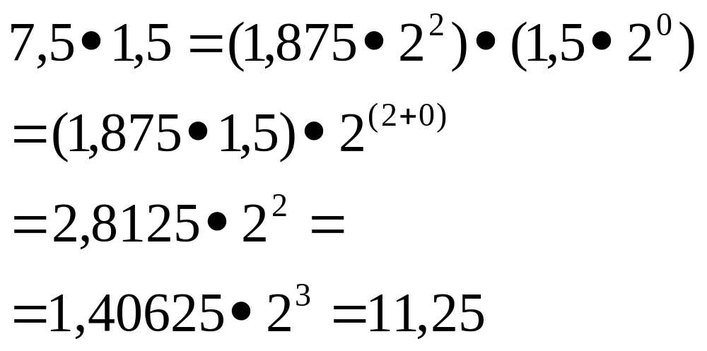
Multiplicación I

Slide 9
Multiplicación
7,5 →
0
10000001
1.11100000000000000000000
1,5 →
X
0
01111111
1.10000000000000000000000
11,25
11,25
0
0
10000001
10000010
10.11010000000000000000000
1.011010000000000000000000

Slide 10
Casos Curiosos I
0 , 4 →
0
01111101
10011001100110011001101
3.9999998e-1
0 ,1 →
0
01111011
10011001100110011001100
9.999999 4 e-2

Slide 11
Casos Curiosos II
Asociatividad :
  A + ( B + C ) ≠ ( A + B ) + C
# include < stdio.h >
int main(){
float a, b, c;
a = -1.0e20;
b = 1.0e20;
c = 0.1;
printf(“ \ n ” );
printf(“ a + (b + c) = % f \n ” , a + (b + c));
printf(“ ( a + b) + c = % f \n ”, (a + b) + c);
}

